Slide 1
Logical Time
Data Structures Week 1
Logical time is a notion we introduce to order events. It provides a mechanism to define the causal order in which events occur at different processes. The ordering is based on the following:
Two events occurring at the same process happen in the order in which they are observed by the process.
If a message is sent from one process to another, the sending of the message happened before the receiving of the message.
If e occurred before e' and e' occurred before e" then e occurred before e".

Slide 2
Causality between events
Think of events happening at a process P_{i}.
One can order these events sequentially,
In other words, place a linear order on these events.
Let h_{i} = {e¹_{i}, e²_{i}, …}, be the events at process P_{i}.
A linear order H_{i} is a binary relation →_{i} on the events h_{i} such that e^{k}_{i} →_{i} e^{j}_{i} if and only if the event e^{k}_{i} occurs before the event e^{j}_{i} at Process Pi.
The dependencies captured by →_{i} are often called as causal dependencies among the events h_{i} at P_{i}.

Slide 3
Causality for msgs
What about events generated due to messages?
Consider a binary relation →_{msg} across messages exchanged.
Clearly, for any message m, send(m) →_{msg} recv(m).
These two relations →_{i} and →_{msg} allow us to view the execution of a distributed program

Slide 4
Causality Definition
One can now view the execution of a distributed program as a collection of events.
Consider the set of events H = U_{i} h_{i}, where h_{i} is the events that occurred at process P_{i}.
Define a binary relation → expressing causality among pairs of events that possibly occur at different processes. → defined as:
e^{x}_{i} → e^{y}_{j} iff
{
i = j and x < y, or
e^{x}_{i} →_{msg} e^{y}_{j}, or
There exists e^{z}_{k} in H s.t. e^{x}_{i} → e^{z}_{k} and e^{z}_{k} → e^{y}_{j}

Slide 5
Logical vs. Physical Concurrency
Two events are logically concurrent if and only if the events do not causally affect each other. In other words, e_{i} || e_{j} ↔ Not(e_{i} → e_{j}) and Not(e_{j} → e_{i}).
Note that for logical concurrency of two events, the events may not occur at the same time.
On the other hand, we define that two events are physically concurrent iff the events occur at the same physical time.

Slide 6
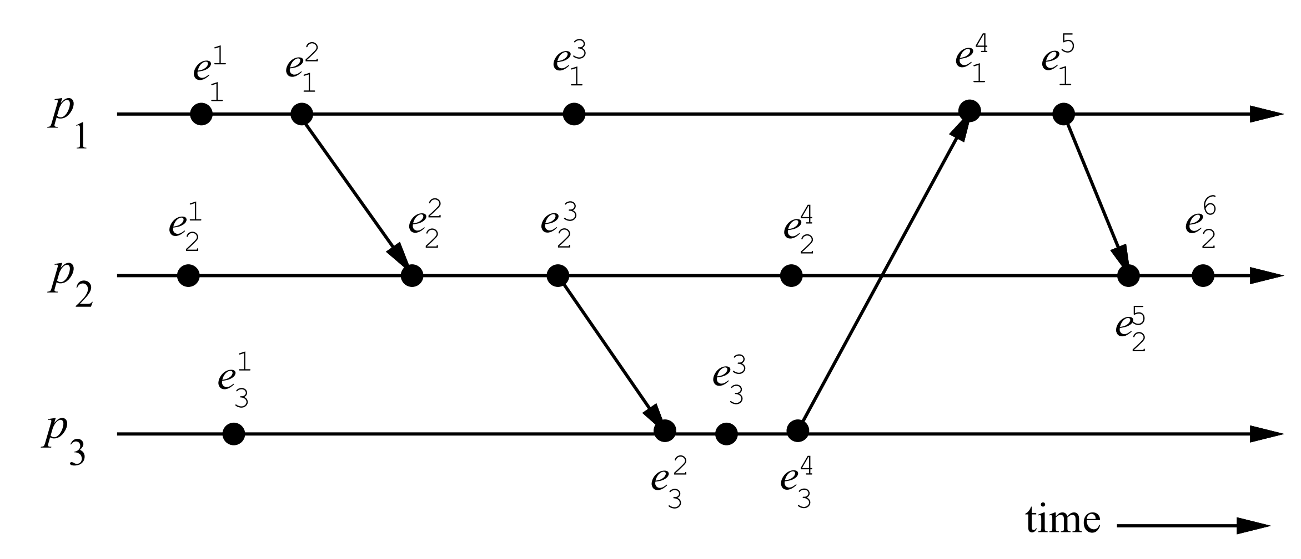
A Distributed Program in Execution
Examples – Find concurrent events, Find some non-trivial (across P_{i}s) precedence among events.

Slide 7
A Distributed Program in Execution
.
Concurrent: e¹₃ and e³₁ ? e⁴₂ and e¹_{3 ?}
Causal: e³₃ → e⁵₁, e²₁ → e³₂, e⁴₃ → e⁵_{1 ?}

Slide 8
Data Structures Week 1
Logical Time
Armed with our notation of events and precedences amongst events, we now study logical time.
We now see how logical time can be maintained in a distributed system.
Three ways to implement logical time -
  scalar time,
  vector time, and
  matrix time
scalar time,
vector time, and
matrix time

Slide 9
Logical Time
Data Structures Week 1
The logical clock C is a function that maps an event e in a distributed system to an element in the time domain T, denoted as C(e) and called the timestamp of e, and is defined as follows:
C : H → T
such that for two events e_{i} and e_{j} , e_{i} → e_{j} ⇒ C(e_{i}) < C(e_{j}).
Elements of T form a partially ordered or totally ordered set set over a relation <.

Slide 10
Logical Time
Data Structures Week 1
Consistent: When T and C satisfy the condition: for two events e_{i} and e_{j} , e_{i} → e_{j} ⇒ C(e_{i}) < C(e_{j}).
This monotonicity property is called the clock consistency condition.
Strongly Consistent: When T and C satisfy the condition:
for two events e_{i} and e_{j} , e_{i} → e_{j} ⇔ C(e_{i}) < C(e_{j}).
then the system of clocks is said to be strongly consistent.

Slide 11
Logical Time
Data Structures Week 1
Each processor needs some data structure to represent logical time.
  A local logical clock, denoted by lc_{i}, that helps process p_{i} measure its own progress.
  A logical global clock, denoted by gc_{i}, that is a representation of process p_{i}’s local view of the logical global time.
    Allows p_{i} to assign consistent time stamps to its local events.
    Typically, lc_{i} is a part of gc_{i}.
Each processor needs a protocol to update the data structures to ensure the consistency condition.

Slide 12
Logical Time
Data Structures Week 1
Each processor needs a protocol to update the data structures to ensure the consistency condition.
  Rule 1: Specify how the local logical clock is updated by a process when it executes an event.
  Rule 2: Specify how a process updates its logical global clock to update its view of the global time and global progress
all logical clocks systems implement Rule1 and Rule2 to maintain the monotonicity property of causality.

Slide 13
Scalar Time
Data Structures Week 1
Proposed by Lamport in 1978
  Lamport won the 2013 Turing award for “contributions to the theory and practice of distributed and concurrent systems, notably the invention of concepts such as causality and logical clocks, .....”.
Time domain is the set of non-negative integers.
The logical local clock of a process p_{i} and its local view of the global time are combined into one integer variable C_{i}.

Slide 14
Scalar Time
Data Structures Week 1
Data structure: The logical local clock of a process p_{i} and its local view of the global time are squashed into one integer variable C_{i}.
Rule1: Before executing an event (send, receive, or internal), process p_{i} executes the following:
C_{i} := C_{i} + d (d > 0)
  Rule 2: Each message piggybacks the clock value of its sender at sending time. When a process p_{i} receives a message with timestamp C_{msg} , it executes the following actions:
    C_{i} := max(C_{i}, C_{msg} )
    Execute Rule1.
    Deliver the message.

Slide 15
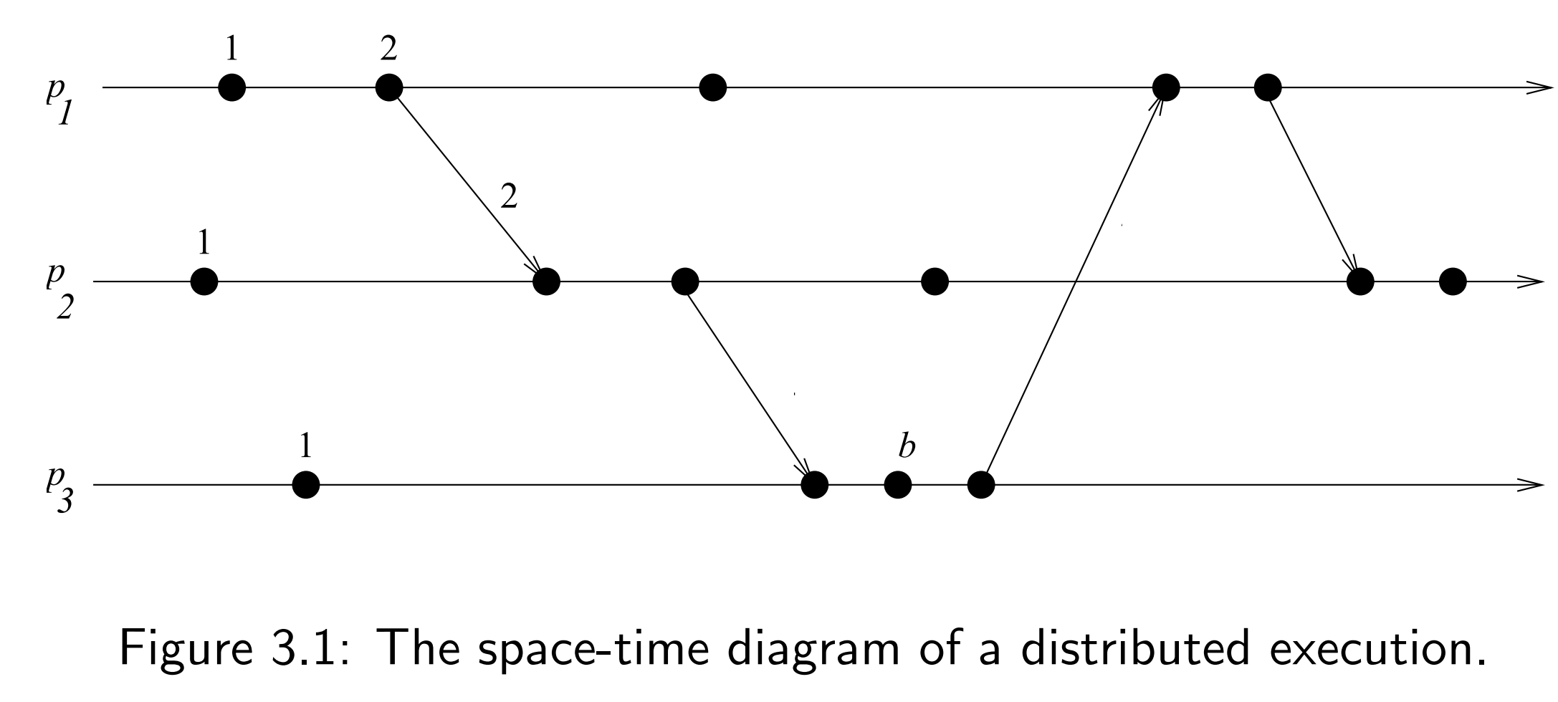
Scalar Time
Data Structures Week 1
Example. Use d = 1 and assign time stamps for the events.

Slide 16
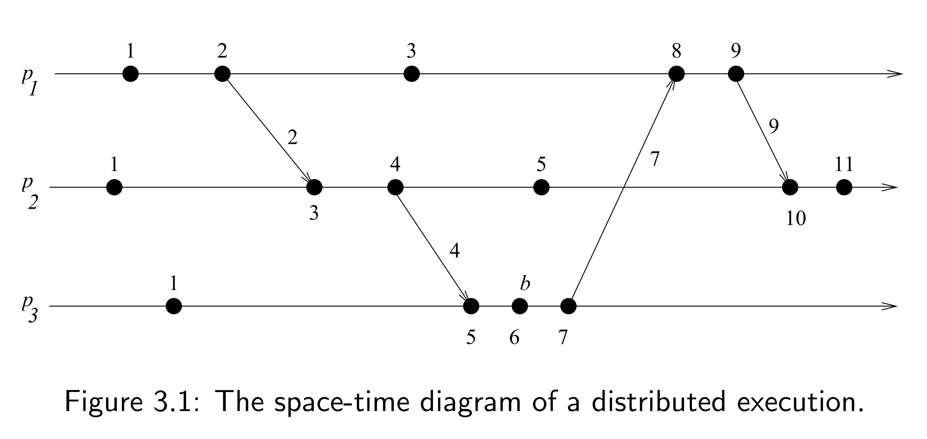
Scalar Time
Data Structures Week 1
Example

Slide 17
Scalar Time Properties
Data Structures Week 1
Monotonicity
  For two events e_{i} and e_{j} , e_{i} → e_{j} ⇒ C(e_{i}) < C(e_{j}).
Total Ordering: Can use the logical time given by the scalar clocks to induce a total order .
  Note that the timestamps alone do not induce a total order.
  Two events at different processors can have an identical timestamp.
  But the tuple (t, i) for each event with (t₁,i₁) < (t₂, i₂) if either t₁ < t₂ or ( (t₁ == t₂) and i₁<i₂) is a total order. In (t,i), t denotes timestamp and i the identiy of the process.
  This total order is consistent with the relation →.
  Note: According to the total order above: For events e1 and e2, e1 < e2 ⇒ Either e1 → e2 or e1 || e2.

Slide 18
Scalar Time: Properties
Data Structures Week 1
Total Ordering: Tie breaking mechanism.Requests are timestamped and served according to the total order based on these timestamp
Consider the tuple (t, i) for each event where
t denotes timestamp and i the identiy of the process.
(t₁,i₁) < (t₂, i₂) if either t₁ < t₂ or ( (t₁ == t₂) and i₁<i₂) is a total order.
This total order is consistent with the relation →.
Note: According to the total order above: For events e1 and e2, e1 < e2 ⇒ Either e1 → e2 or e1 || e2.

Slide 19
Scalar Time
Data Structures Week 1
Event Counting:
Strong Consistency:
Sriram Murthy

Slide 20
Scalar Time
Data Structures Week 1
Event Counting: Set the increment d to 1 always.
If some event e has a timestamp t, then e is dependent on t – 1 other events to occur.
This can be called as the height of event e.
No Strong Consistency: Note that scalar time does not provide strong consistency. [Strong consistency requires that e_{i} → e_{j} ⇔ C(e_{i}) < C(e_{j}).]
  Example suffices. Refer to the timeline again.
Sriram Murthy

Slide 21
Scalar Time
Data Structures Week 1
No Strong Consistency: Consider third event of p₁ and p₂.

Slide 22
Out of order messages
Data Structures Week 1
First P1→a P3
Next P1 →c P2
Then, P2 →b P3
At P3, it is possible that b arrives before a (though a was sent before).
When b arrives:
-P3 does not know whether a msg with lower timestamp might arrive
- Even if a arrives with lower timestamp, P3 can not know whether a actually happened before b as b is coming from P2 (following its own count) and a has come from P1.

Slide 23
Scalar Time: Limitation
Data Structures Week 1
One of the limitations of scalar time is the lack of strong consistency.
Strong consistency not achieved as scalar time uses a single time that represents the logical local clock and the logical global clock.
  This means that the causality of events across processors is lost. That is, by looking at the times we can not make out which two events are casually related and which two are not.
  Vector time solves this problem but with big data structures.

Slide 24
Vector Time
Data Structures Week 1
Time is represented by n-dimensional non-negative integer vectors.
Each process p_{i} maintains a vector vt_{i} [1..n], where vt_{i}[i] is the local logical clock of p_{i} and describes the logical time progress at process p_{i}.
Vt_{i}[j] represents process p_{i} ’s latest knowledge of process p_{j} local time.
If vt_{i} [j]=x, then process p_{i} knows that local time at process p_{j} has progressed till x.
The entire vector vt_{i} constitutes p_{i} ’s view of the global logical time and is used to timestamp events.
The timestamp of an event is the value of the vector clock of its process when the event is executed.

Slide 25
Vector Time – Update Rules
Data Structures Week 1
Rules for Process p_{i} to update its clock:
Rule 1: Before executing an event, process p_{i} updates its local logical time as follows:
vt_{i} [i] := vt_{i}[i] + d where (d > 0)
Rule2: Each message m is piggybacked with the vector clock vt of the sender process at sending time. On the receipt of such a message (m,vt), process p_{i} executes the following sequence of actions:
    Update its global logical time as follows:
    1 ≤ k ≤ n : vt_{i}[k] := max(vt_{i}[k], vt[k])
    Execute Rule1.
    Deliver the message m.

Slide 26
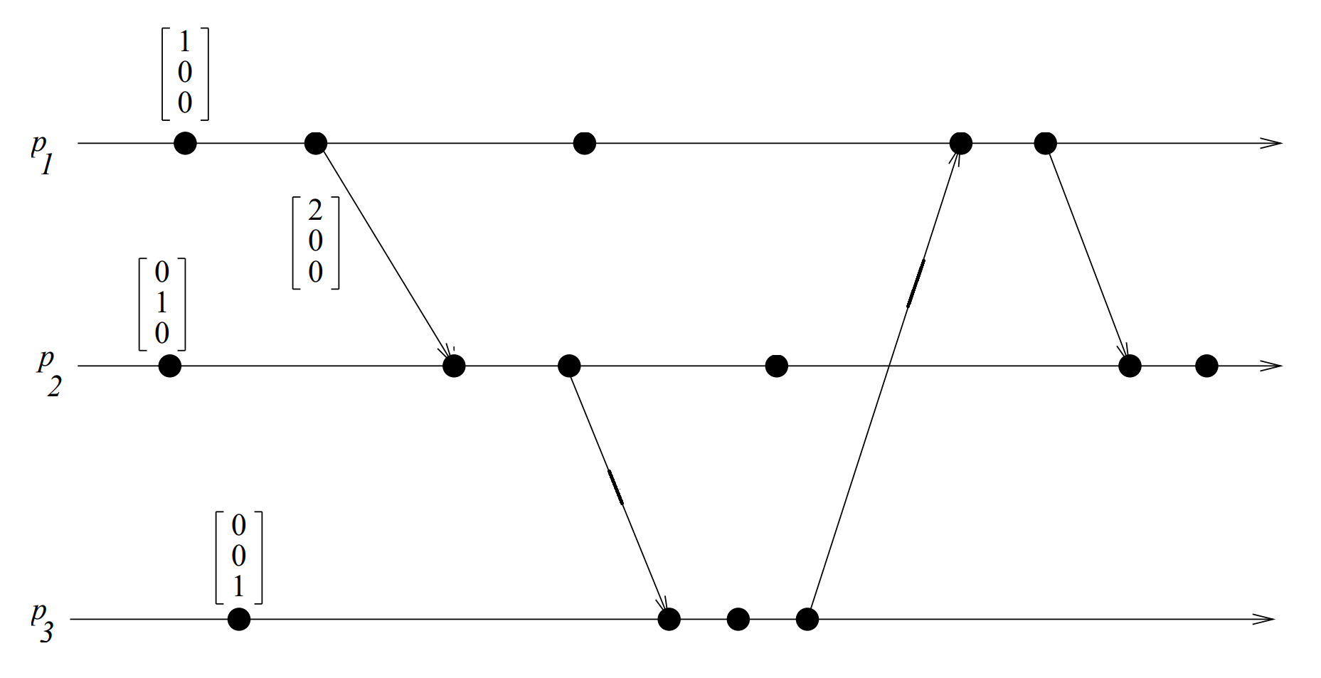
Vector Time – Example
Data Structures Week 1
P2’s second event:
max([2,0,0], [0,1,0])=[2,1,0]
Then Rule1: [2,2,0]

Slide 27
Data Structures Week 1
For process i, for d=1, are the events internal to the process ordered as a sequence1,2,3,4,.... Or could there be jumps ?

Slide 28
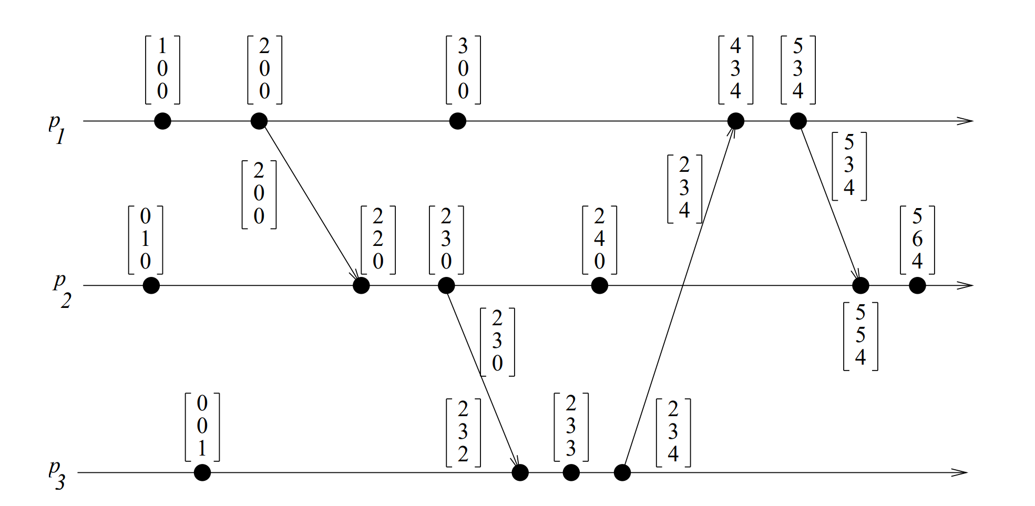
Vector Time – Example
Data Structures Week 1
Initially, a vector clock is [0, 0, 0, ...., 0]. d = 1.
Fill the timestamps for the other events.

Slide 29
Vector Time – Example
Data Structures Week 1
Using vector clocks, two timestamps vh and vk are compared as follows.
vh == vk iff for all indices i, vh[i] == vk[i]
vh <= vk iff for all indices i, vh[i] ≤ vk[i]
vh < vk iff vh ≤ vk and there exists an index i where vh[i] < vk[i].
vh || vk iff not(vh < vk) and not(vk < vh)

Slide 30
Properties of Vector Time
Data Structures Week 1
Event Counting: Use d = 1 always.
Then the i th component of vector clock at process p_{i},vt_{i}[i], denotes the number of events that have occurred at p_{i} until that instant.
So, if an event e has timestamp vh, vh[j] denotes the number of events executed by process p_{j} that causally precede e.
How many events causally precede e in the distributed computation ?

Slide 31
Properties of Vector Time
Data Structures Week 1
Event Counting: Use d = 1 always.
Then the i th component of vector clock at process p_{i},vt_{i}[i], denotes the number of events that have occurred at p_{i} until that instant.
So, if an event e has timestamp vh, vh[j] denotes the number of events executed by process p_{j} that causally precede e. Clearly, (Σ_{j} vh[j] ) − 1 represents the total number of events that causally precede e in the distributed computation.

Slide 32
Properties of Vector Time
Data Structures Week 1
Are Vector clocks strongly consistent ?

